Slide 1


Introduction to Python Programming: A Comprehensive Guide for Absolute Beginners
Muhammad Zohad Ijaz, Mariam Ashraf
Muhammad Hateem Hussain, Muhammad Atif

Slide 2
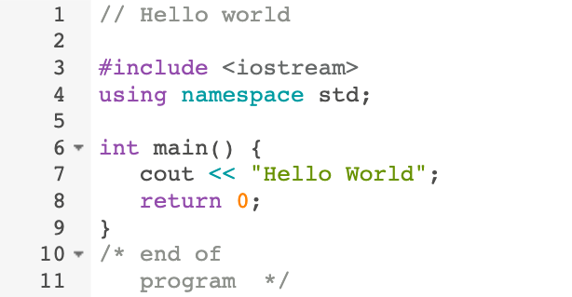
Introduction to Programming Language
A programming language is an artificial language that can be used to control the behavior of a machine, particularly a computer.
Examples are: Python, Ruby, Java, JavaScript, C, C++, and C#.
Programming languages are used to write all computer programs and computer software. A programming language is like a set of instructions that the computer follows to do something.

Slide 3
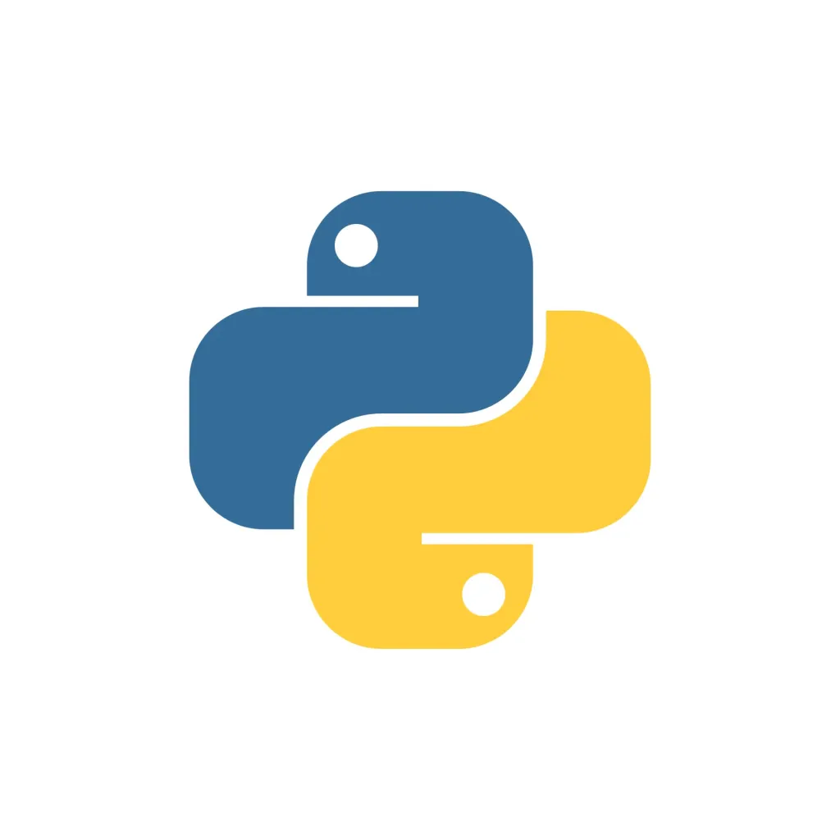
INTRODUCTION TO PYTHON
Python is a popular programming language.
It was created by Guido van Rossum, and released in 1991!
We will explore the fundamentals of Python, its applications, and how to get started with coding in this powerful language. Let’s embark on this exciting journey together!

Slide 4
WHAT IS PYTHON? & WHY PYTHON?
Python is used in various domains such as web development, data analysis, and artificial intelligence. Its versatility makes it a popular choice for beginners and professionals alike.
Python works on different platforms (Windows, Mac, Linux, Raspberry Pi, etc).
Python has a simple syntax similar to the English language.
Python has a syntax that allows developers to write programs with fewer lines than some other programming languages.
Python runs on an interpreter system, meaning that code can be executed as soon as it is written. This means that prototyping can be very quick.
Python can be treated in a procedural way, an object-oriented way or a functional way.
Python is an Interpreter based Not a Compiler based

Slide 5
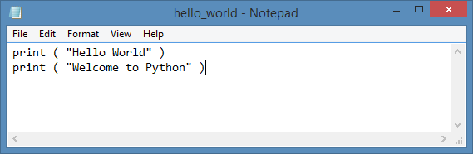
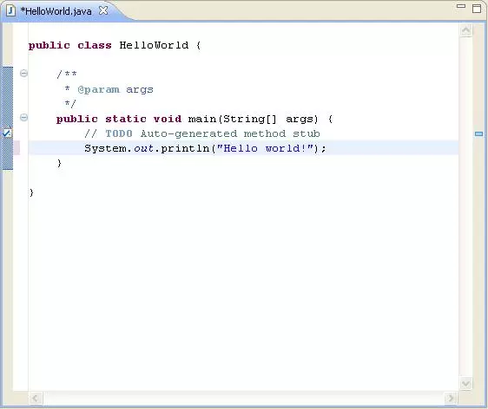
Python VS Other Languages Syntax
Comparative Analysis
Python
C++
JAVA

Slide 6

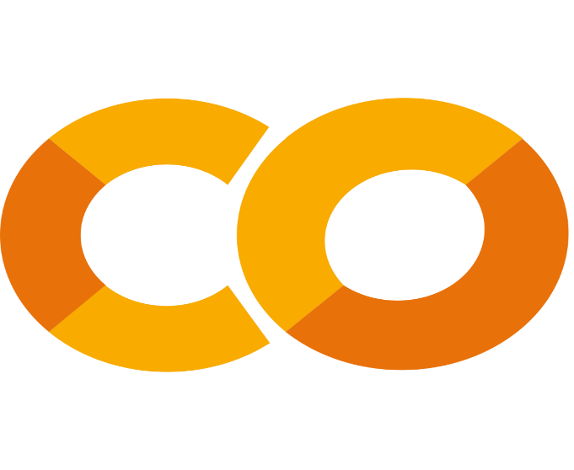
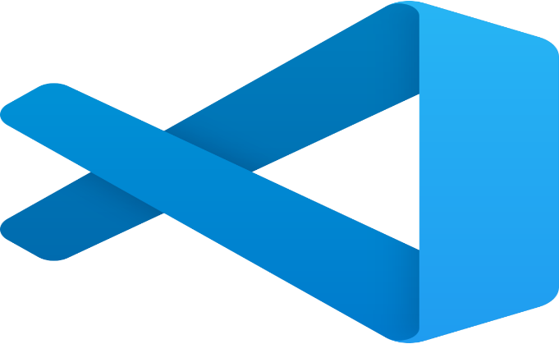
SETTING UP PYTHON
To start programming in Python, you need to install the Python interpreter on your computer. Visit the official Python website, download the latest version, and follow the installation instructions. Once installed, you can run Python scripts using an IDE or a simple text editor.
There are Multiple IDEs to write code of Python like Python Jupiter and Google Colab but We will use Google Colab Visual Studio code in short vs code
VS CODE
Google Colab

Slide 7
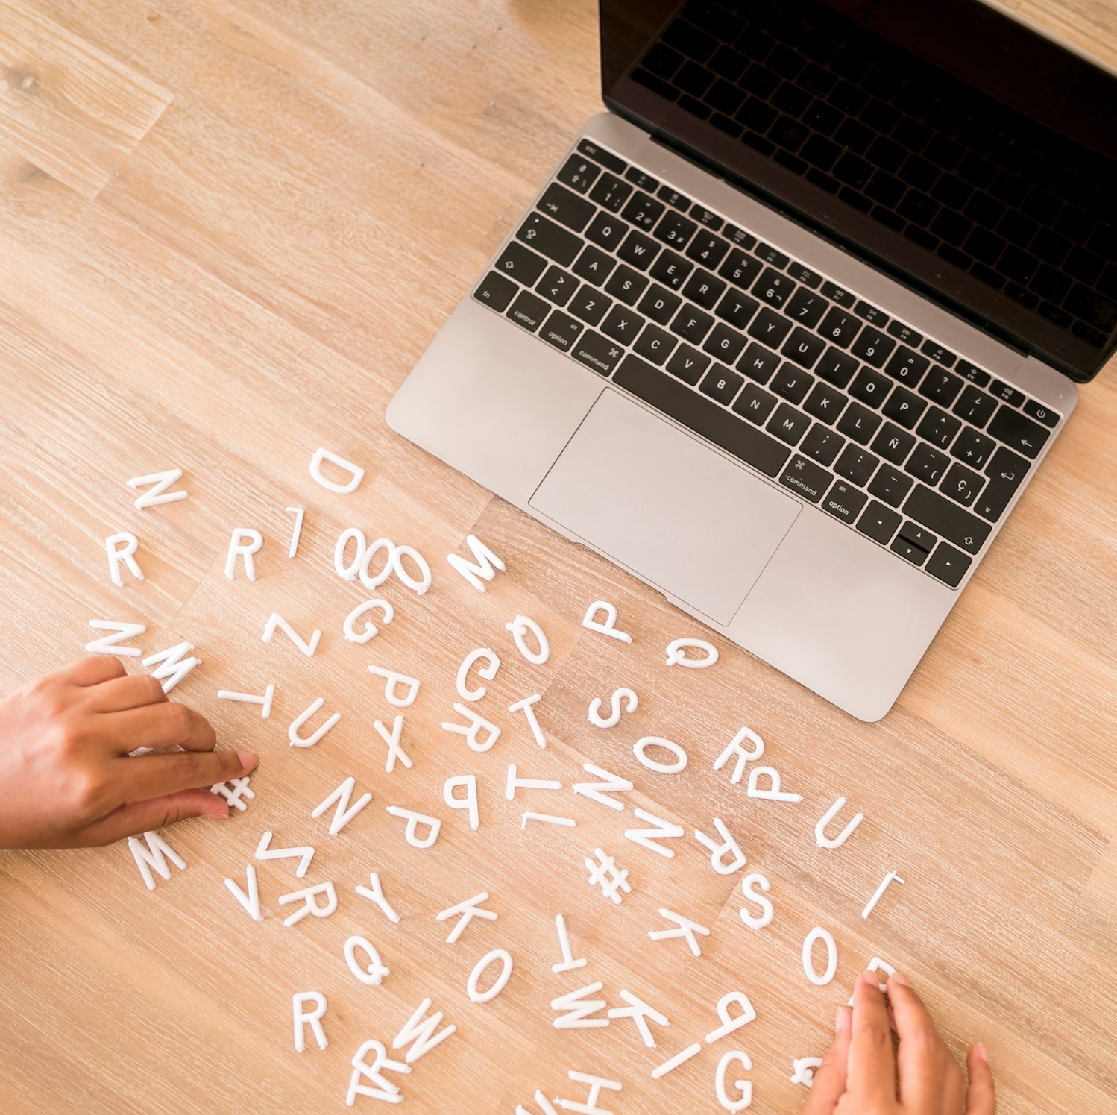
BASIC SYNTAX
Python’s syntax is designed to be intuitive and easy to learn. Understanding these fundamentals is crucial for writing eﬀective Python code. It's important to practice writing simple scripts to become familiar with the syntax.
Control Structures
Control structures such as if statements, loops, and functions are essential for creating dynamic programs. They allow you to control the ﬂow of your code and make decisions based on conditions. Mastering these concepts will enable you to build more complex applications.

Slide 8
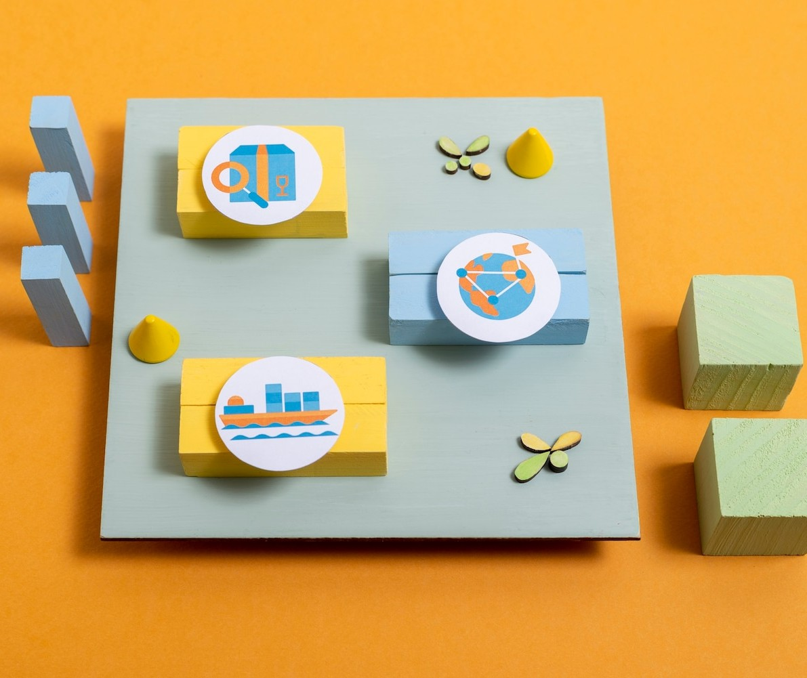
FUNCTIONS AND MODULES
DATA STRUCTURES
Python oﬀers several built-in data structures like lists, tuples, sets, and dictionaries. Each structure serves a unique purpose and is optimized for diﬀerent types of operations.
Understanding these data structures is vital for efficient data management in your
programs.
Functions in Python are defined using the def keyword and help organize your code into reusable blocks. Modules allow you to import and utilize code from other files. Learning to create and use functions and modules is key to writing modular and maintainable code.

Slide 9




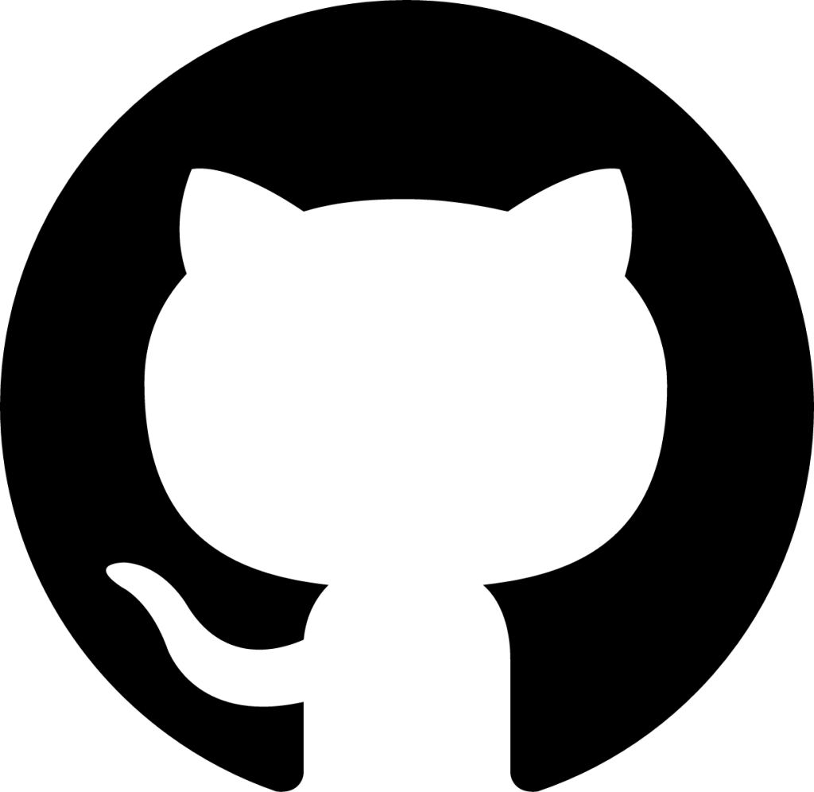
Thanks!
Do you have any questions?
zohadijaz786@gmail.com
Reach out to me by clicking below.
LinkedIn Profiles:
Muhammad Hateem Hussain
Mariam Ashraf
Muhammad Atif

